Slide 1
Introduction to Accessibility

Slide 2
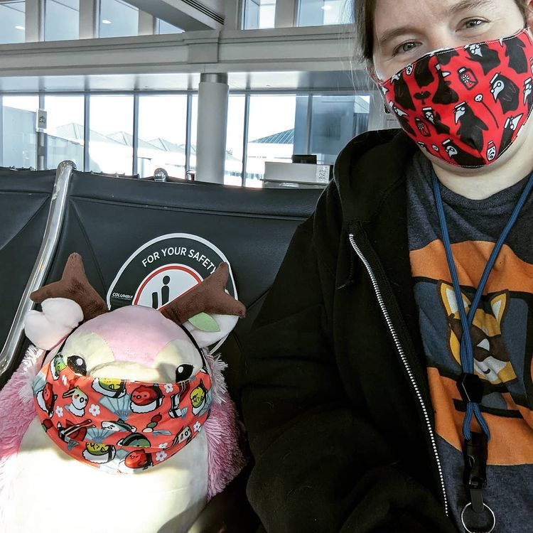
Little bit about me!
Current Site Reliability Engineer with CloudFit Software
Former IT employee at the American Printing House for the Blind
Graduated from WKU with a BA in Sociology
DHS certified Trusted Tester

Slide 3

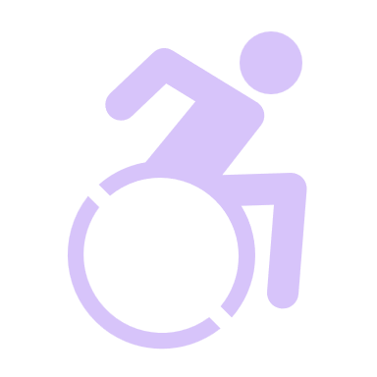
What is Accessibility?
Accessibility – Accessibility is defined as a "word used to describe whether a product can be used by people of all abilities." - Microsoft Accessibility Fundamentals
Disability – Disability is defined as "a mismatch in interaction between the features of a person's body and the features of the environment in which they live.“- Microsoft Accessibility Fundamentals
Assistive Technology – “…any item, piece of equipment, software program, or product that is used to increase, maintain, or improve the functional capabilities of people with disabilities.” – Assistive Technology Industry Association (ATIA)
Notes:
“A disability is any condition of the body or mind (impairment) that makes it more difficult for the person with the condition to do certain activities (activity limitation) and interact with the world around them (participation restrictions).” – CDC
Assistive Technology seeks to offset the mismatch between a person and their environment.

Slide 4
Why is it important?
It’s for everyone
Attract / Keep diverse customers & employees
Possible lawsuits
Because it is the right thing to do
Many Accessibility improvements end up helping a wider audience than they were originally designed for.
Curb cut effect is a great example.
Improve people’s ability to be active participants in society and improve their quality of life.
According to the CDC, 1 in 4 Americans have some type of disability.
According to 3PlayMedia, Accessibility lawsuits increased by 181% between 2017 and 2018 alone.
Not doing so:
Is discrimination
Pushes people into poverty
Causes the spread of misinformation
Kills people
Blocks information access
The costs of the lawsuits can be staggering, both in terms of financial cost and public image.
Customers and employees are drawn to places where they feel represented and respected.
Notes:
Often, we are made to think that Accessibility is expensive, but often the expense comes from being reactive rather than proactive. If we don’t bake accessibility in from the beginning, we end up having to go back to redo things. This creates extra tech debt in the form of the time spent fixing things when it could have been avoided by doing things right from the beginning. Accessibility needs to be treated as an integral part of any project, rather than an extra feature added for convenience.
When things are not accessible it can lead to people feeling and being isolated, cause them to not have access to the same opportunities, etc.
It can cause people to have trouble making good decisions for themselves and others due to lack of up to date, pertinent information This has heavily seen in the current pandemic where individuals with disabilities accounted for in some areas as many as 6 in 10 of the deaths from COVID. This is often attributed to these individuals having a harder time accessing information on prevention, resources, and more that would have helped them.
Sources for statistics include:
CDC – https://www.cdc.gov/ncbddd/disabilityandhealth/infographic-disability-impacts-all.html
Kentucky Specific: https://www.cdc.gov/ncbddd/disabilityandhealth/impacts/pdfs/Kentucky_Disability.pdf
Essential Accessibility – https://www.essentialaccessibility.com/blog/web-accessibility-lawsuits/
3Play Media Article –https://www.3playmedia.com/blog/2018sweb-accessibility-lawsuits/
BBC Article - Covid: Disabled people account for six in 10 deaths in England last year - https://www.bbc.com/news/uk-56033813

Slide 5
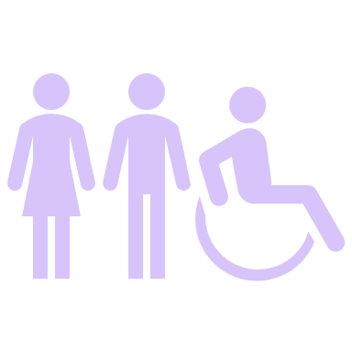

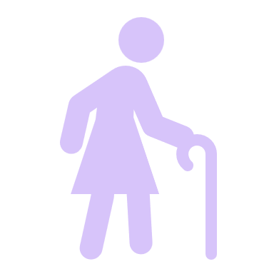

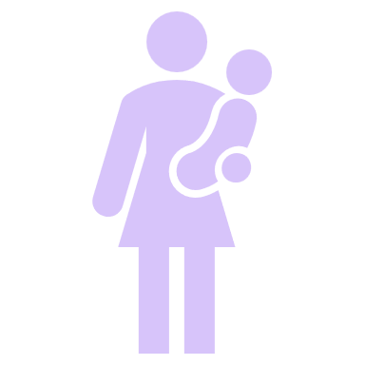
Social Model
Notes:
The medical model is generally what people think about when they think about Accessibility. It focuses on accessibility needs that stem from medical conditions. The problem with the medical model is that is ignores situations where there may not necessarily be a medical need for Accessibility assistance to help an individual to adapt to and function within their environment. Therefore, the social model of Accessibility has become more prevalent.
The Social model focuses on the fact that we can impacted by a need for Accessibility in situations that aren’t necessarily medical. For example, a construction worker working with loud equipment has their hearing hindered while the equipment is running. They need hearing protection to protect their hearing, and safety equipment to avoid other dangers that can be caused by their situational hearing loss. They may have noise cancelling headsets with built in radios so individuals can communicate with them while also protecting their hearing from the environmental noise.

Slide 6

Accessibility Time
Accessibility needs can be Temporary, Permanent, and Situational in terms of how long they impact someone.
Temporary – broken bone, temporary hearing loss, having to cover your eye(s) while they heal after an event, pain after surgery,
Permanent – loss of a limb, permanent vision or hearing loss
Situational – temporarily panicked due to pet possibly being poisoned or something catching fire.
They can also vary in severity when it comes to how they impact to your daily life.

Slide 7

Visible/Invisible
Notes:
Disabilities can be visible or invisible. Examples of visible disabilities could include being wheelchair bound, walking with a cane, a missing limb, eye patch, or other such indicators that are clearly visible and quickly identifiable as causing a disability. Examples of invisible disabilities could be someone having PTSD, dyslexia, Autism, spina bifida, other other such conditions where the fact that the individuals has a disability is not readily apparent to observers.

Slide 8
Accessibility Categories
Hearing
Vision
Mobility
Comprehension
Technological Access
State of Panic
Notes:
People categorize accessibility needs differently. For example, the CDC lists mobility, hearing, cognition, vision, self-care, and independent living.
We typically associate accessibility with medical causes like age, illness, injury, genetic conditions, etc. However, per the social model for Accessibility, there are non-medical instances to consider.
Hearing
Loud work or entertainment venues (i.e., rock concert, construction site, or factory equipment) can result in temporary or permanent hearing loss.
A lot of background noise, accents, or sounds and voices that fall within certain frequencies can also cause hearing issues for individuals.
Ways to help:
Captioning
Don’t censor captions if the audio is not censored
Don’t solely depend on audible cues
Wear/provide hearing protection
Vision
We also tend to assume, wrongly, that someone who is blind can’t see anything. Many individuals who are blind still have some sight. Their ability to perceive light levels, colors, defined shapes, and such may just vary, or they may just need to get closer to see things in a way that does impede their ability to do some tasks without assistance from assistive technology or other individuals.
According to WebMD, “If you're legally blind, your vision is 20/200 or less in your better eye or your field of vision is less than 20 degrees. That means if an object is 200 feet away, you have to stand 20 feet from it in order to see it clearly. But a person with normal vision can stand 200 feet away and see that object perfectly.”
Sight can also be impaired due to fog, lack of lighting, having your eyes dilated, a bright flash of light in your face, being in an area with lots of visual interference, etc.
Ways to help:
Offer audio and visually descriptive transcripts and captions
Don’t censor captions if the audio is not censored
Make sure they aren’t baked into the video
Ensure good contrast
Mobility
Holding a baby, carrying a heavy/large object, pulling luggage around, rough terrain, barriers present in path of travel, and more can lead to your mobility being impacted.
Curb cut effect
The curb cut effect is when something meant to help a particular group ends up gaining widespread adoption because it provides benefits to more people.
Ways to help:
Removing physical barriers where possible
Providing properly designed ramps
Large touch areas for touch screen buttons
Good grips on handles
Comprehension
Some medical causes can include dyslexia, dyscalculia, autism, various sensory processing disorders, etc. Too much background noise can lead to issues for people who are easily overwhelmed by visual or audio stimulation, or who have trouble focusing when there is too much going on.
Some non-medical situations can include not using the right language, using language not at an appropriate knowledge level for the audience, etc.
Ways to help:
Ensure appropriate comprehension level for content (i.e. grade level, language complexity, language)
Avoid overly complicated language (i.e. think legalese)
Use fonts that are built to be more easily read by people with dyslexia
Avoid unnecessary background noise or visual stimulation
Technological Access
Slow internet, inconsistent connection, older computer, no printer, or poor access to accessibility technology can be forms of Technology Access issues.
Ways to help:
Don’t make apps resource heavy
Digital submission options
Backwards compatibility where able
State of Panic
Think about the last time your internet was down and you were looking up the tech support number, or navigating the menus to speak with someone. You probably weren’t feeling at your best to begin with. The longer it takes you to find information or the more difficult it is to navigate to where you need to go, the more frustrated you will be when you finally get the information you need.
When information you will typically try to find when the situation isn’t at its best is difficult to access, this can create a bad user experience. Users will form a poor perspective of your application and/or service and will be more likely to cause trouble for support agents who have to directly interact with them.
Navigating information can be made more difficult when you are under stress. You may have trouble focusing or thinking things through.
Examples could include:
Looking for a support number when a necessary service is down.
Looking up physician contact information when sick.
Looking up a poison control contact number when you think a pet or child has ingested something dangerous.
Ways to help:
Make important information quick to get to, if not right up front.
Simple, clear navigation
Give multiple options for how to navigate menus so people can use what is easiest for them.

Slide 9
Accessibility Standards
WCAG
ADA
Section 508 Compliance
Notes:
WCAG is version 2.1 as of June 2018.

Slide 10
WCAG
Web Content Accessibility Guidelines (WCAG)
Separated into 3 levels: A, AA, and AAA
Separated into 4 basic principles: Perceivable, Operable, Understandable, and Robust. These are often shortened to POUR.
Created by the World Wide Web Consortium (W3C). Serves as the basis for most development and Accessibility standards worldwide.

Slide 11
ADA
“The Americans with Disabilities Act (ADA) prohibits discrimination against people with disabilities in several areas, including employment, transportation, public accommodations, communications and access to state and local government’ programs and services. As it relates to employment, Title I of the ADA protects the rights of both employees and job seekers. The ADA also establishes requirements for telecommunications relay services. Title IV, which is regulated by the Federal Communications Commission (FCC), also requires closed captioning of federally funded public service announcements.” – US Department of Labor
Signed into law July 26, 1990 by George H.W. Bush.
Meant for general overall public Accessibility access.
Has some sections for more specific areas like employment.

Slide 12
Section 508
“Section 508 of the Rehabilitation Act (29 U.S.C. § 794d) requires federal agencies to develop, procure, maintain or use Information and Communications Technology (ICT) that is accessible to people with disabilities – regardless of whether or not they work for the federal government.” – EPA.gov
Section508 generally applies to groups providing government funded services, government contractors, and government departments.
Also often paired with Section 255 of the Communications Act.

Slide 13
What can I do?
ARIA where appropriate
Semantic HTML
People first language
Appropriate Alt Text
Listen and speak up
Think about Accessibility early and at all stages of any project you work on.
Meet standards: W3, ADA, WCAG (AA), Section 508, etc.
Notes:
ARIA as defined by the MDN:
“Accessible Rich Internet Applications (ARIA) is a set of attributes that define ways to make web content and web applications (especially those developed with JavaScript) more accessible to people with disabilities.”

Slide 14
Tools and Resources
Google Accessibility
WebAIM offers a lot of tools and documentation for testing Accessibility including a browser extension.
Accessibility Insights is a tool set offered by Microsoft for testing Accessibility in Android apps, Websites, and Windows applications.
There are also built in Accessibility checkers in the Office 365 web and desktop applications, which offer similar functionality.
CorgiDev Accessibility Resources and Information
American Printing House for the Blind
Microsoft’s Accessibility Fundamentals Course
Microsoft Accessibility (@MSFTENable) on Twitter

Slide 15
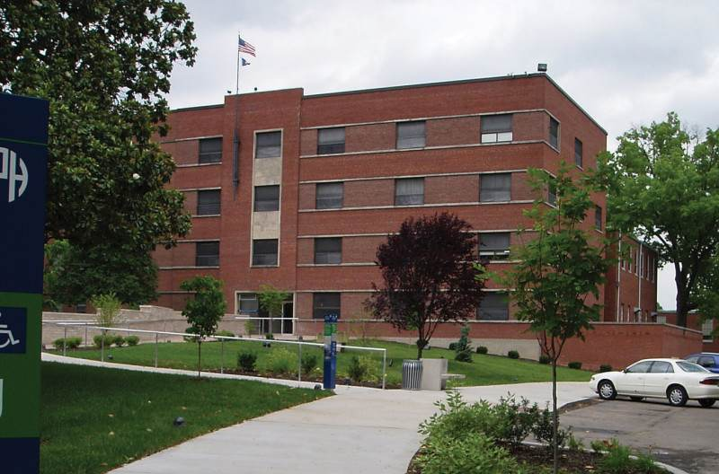
American Printing House for the Blind
Notes:
Est. in 1858 by the Kentucky General Assembly through an Act.
Further funded and established in 1879 as a major provider of educational materials to students with visual Accessibility needs through the first act to benefit students with visual needs through the "Act to Promote the Education of the Blind" provides funding to the Printing House for embossed books and apparatus for blind students throughout the country. This funding continues today through the Federal Quota Program.
Open Monday – Friday for tours and museum. I recommend visiting Monday – Thursday when the factory is more likely to be open unless Inventory is going on. Check out https://sites.aph.org/museum/visit/ for more details.

Slide 16
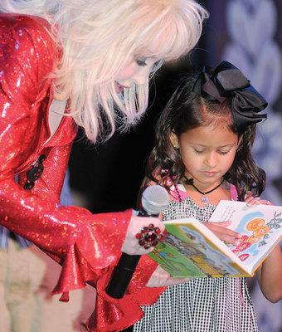

Imagination Library and Braille Tales
Notes:
You can learn more about Braille Tales and Dolly Parton’s Imagination Library at the following web address: https://sites.aph.org/dolly-partons-imagination-library/.
You can also go to the official page for Dolly Parton’s Imagination Library located, here: https://imaginationlibrary.com/

Slide 17

Keep in touch!
Home Page Corgidev.com
LinkedIn @CorgiDev
Twitter @TheCorgiDev
Twitch @TheCorgiDev
GitHub @CorgiDev

